Slide 1


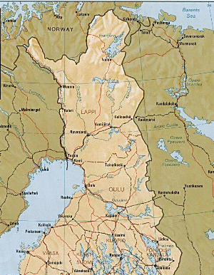

Towards standard APIs for the exchange of metadata between
homelab LIMS software and ISPyB
Diamond
January 31, 2018
Rik Wierenga
FBMM
University of Oulu
Oulu
Finland

Slide 2

4 senior postdocs
2 technical staff
7 research groups
used for research
and teaching

Slide 3
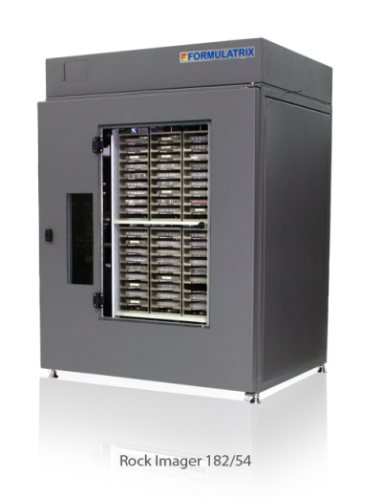
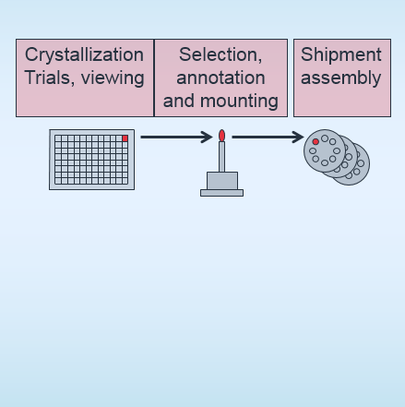
crystallization crystal treatment data collection
IceBear ISPyB
user
crystal data
links
links
crystallisation conditions links
/structures: raw data
(raw data,
log-files,
PDB deposition)
homelab
synchro
-In our research group we collect the raw data plus the important log files in /structures
-The University of Oulu aims to make archiving and open-access of raw data possible
-Research Data Management is an important issue of national science policy in Finland

Slide 4

Towards standard APIs for the exchange of metadata between
homelab LIMS software and ISPyB
Oulu (Rik Wierenga)
Diamond (Alun Ashton)
Weizmann (Joel Sussman)

Slide 5
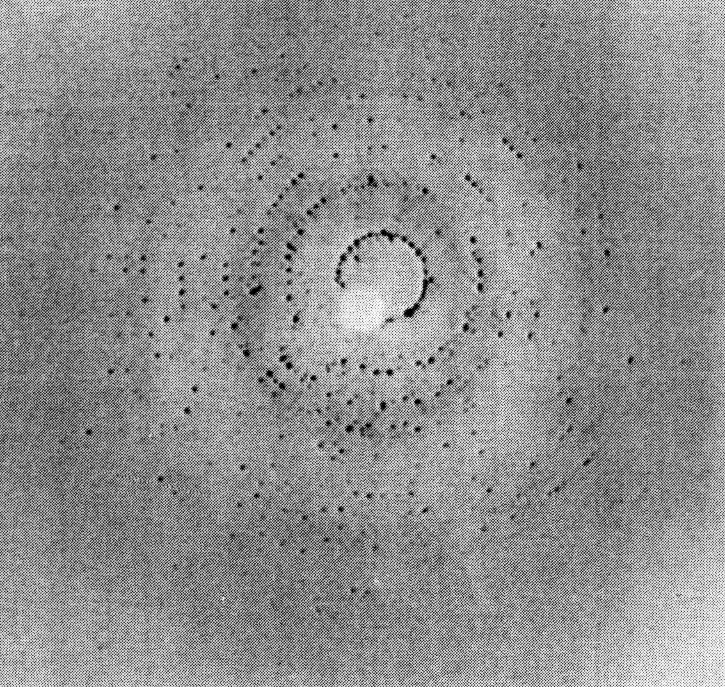
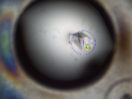
API
Synchrotrons, beamlines
API
ISPyB
1
API
2
meta data
RI54/
RockMaker
Formulatrix
IceBear
API, jointly by Diamond/Oulu/Weizmann
API, jointly by Diamond/Oulu/Weizmann
One-shot delivery of meta-data to ISPyB (Ed Daniel, Karl Levik)
Homelab data base, important for education, research-data-management, publications
Where is the raw data? /structures

Slide 6
frozen crystal shipment
chosen crystals:
-protein acronym
-sequence information
-crystal-identifier (TIM-9098A1D2C1-“pinbar-code”-“user-part”) (sample name) -pin-barcode
-identification of the dewar
--position in the puck
--position of puck in the dewar
-URL of crystal selection page
-ligand
-cryo information
-crystallization well solution
-protein buffer
-remarks
anything else?? (authentification, proposal-nr, toxicity, lab contact)
Retrieval of META data
Cross-reference of homelab-LIMS-crystal-identifier (crystal-ID) and synchrotron-ISPyB-pin/crystal-identifier (ISPyB-ID)

Slide 7
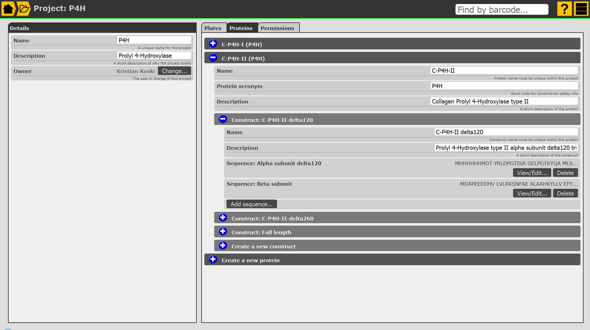

Slide 8
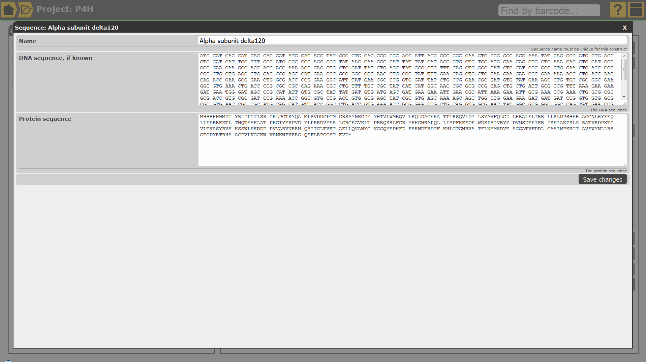

Slide 9
frozen crystal shipment
chosen crystals:
-protein acronym
-sequence information
-crystal-identifier (TIM-9098A1D2C1-“pinbar-code”-“user-part”) (sample name) -pin-barcode
-identification of the dewar
--position in the puck
--position of puck in the dewar
-URL of crystal selection page
-ligand
-cryo information
-crystallization well solution
-protein buffer
-remarks
anything else?? (authentification, proposal-nr, toxicity, lab contact)
Retrieval of META data
Cross-reference of homelab-LIMS-crystal-identifier (crystal-ID) and synchrotron-ISPyB-pin/crystal-identifier (ISPyB-ID)

Slide 10
API
Synchrotrons, beamlines
API
ISPyB
1
API
2
meta data
RI54/
RockMaker
IceBear
Can it work for all synchrotrons?
Authentification issues, address together with CSC (Finland) / ELIXIR?
(can we still link back to the ISPyB-link 5-10 years later?)

Slide 11
API
Synchrotrons, beamlines
API
ISPyB
1
API
2
API
DIFFRACT
Bruker
platescanner
device
RI54/
RockMaker
IceBear
API
1
3
Platescanning: Bruker is interested to develope their DIFFRACT software such that it
can use the API. Subsequently the diffraction information is transferred
back into the homelab data base, together with the crystallization data.

Slide 12
RI1000/
No RockMaker
Synchrotrons, beamlines
API
ISPyB
CRIMS
API
1
API
2
API
DIFFRACT
Bruker
platescanner
device
RI54/
RockMaker
IceBear
API
1
3

Slide 13
data to be shipped to ISPyB concerning plate shipments:
every plate:
-protein acronym
-sequence information
-plate bar code
-plate type
-drop mapping
chosen crystals:
-crystal identifier
-drop identifier
-drop image
-cross hair (x,y) in drop-image-coordinates
-URL of crystal selection page
-remarks
anything else?? (authentification, proposal-nr, toxicity, lab contact)
every plate gets a task-list
drop-image superposition?
Is it possible to get back for every item of the tasklist an ISPyB-link, to be stored in
the homelab data base?

Slide 14
API
Synchrotrons, beamlines
API
ISPyB
1
API
2
meta data
RI54/
RockMaker
IceBear
Current activities
-API-1
-sending a shipment of frozen crystals

